Slide 1
What Is Programming?

Slide 2
Instruction To Computer
Programs
Computer Programmer
Programming Language

Slide 3
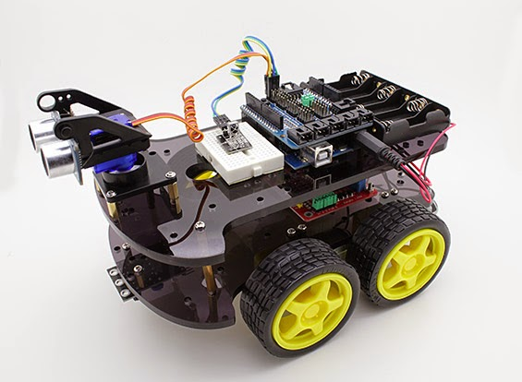
ARDUBOT

Slide 4
Basic Commands For Ardubot
moveForward();
moveBackward();
moveLeftMotor();
moveRightMotor();
turnLeft();
turnRight();
brake();

Slide 5
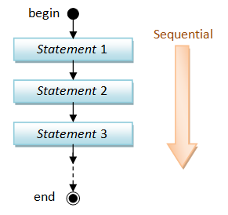

Slide 6
Its Time For SuperArduBot
Command to move SuperArdubot
moveRobot( leftSpeed, rightSpeed);
values of speed = {STOP,SLOW,FAST}
For Examples:
moveRobot(SLOW,SLOW);
Command to get distance
getDistance();
Command To Check front is blocked
isFrontBlocked();

Slide 7
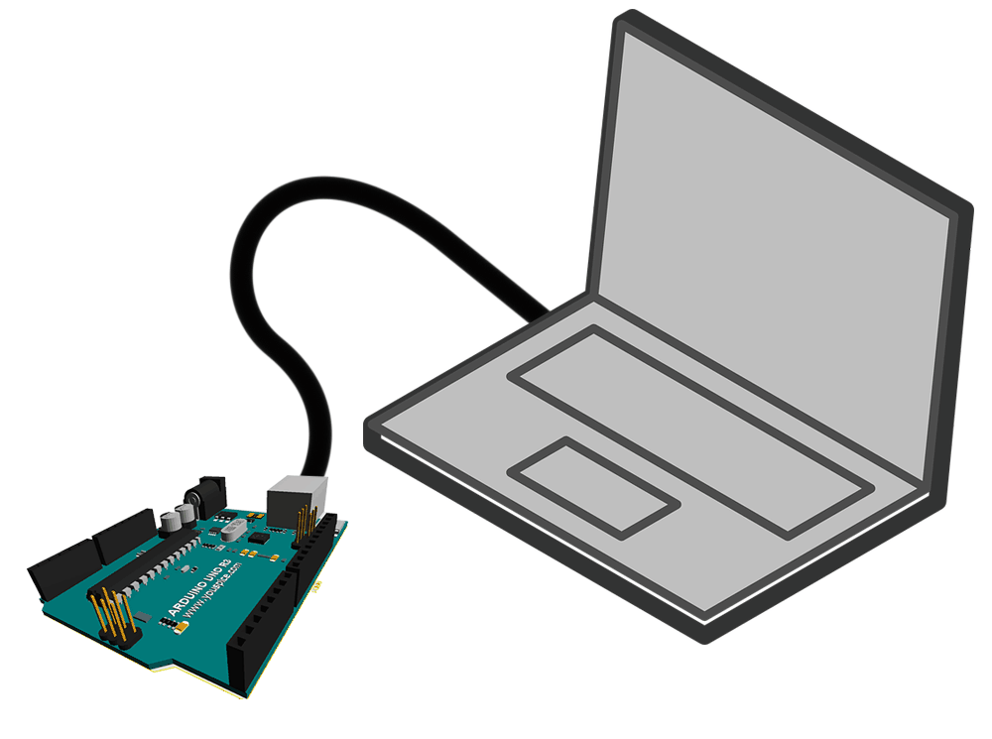
Serial Monitor
Serial.begin(9600);
Serial.println();
delay(1000);

Slide 8
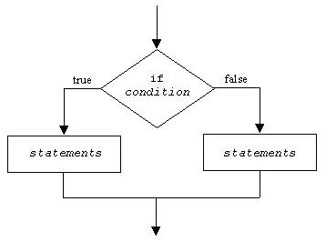
Branching

Slide 9
What is a variable?
Name of a location that holds a value with which we are working.
Placeholder for a value
Data types in C Programming
Int
Float
Double
Char

Slide 10
Add 2 Integer Numbers
Program for adding 2 Integer numbers is as below:
int n1=10;
int n2=20;
int total=n1+n2;
n1
n2
Total
10
20
30

Slide 11
Operators and Operands
As in most languages, Arduino programs specify computation in the form of arithmetic expressions that closely resemble expressions in mathematics.
The most common operators in Java are the ones that specify arithmetic computation:
+ Addition * Multiplication
Subtraction / Division
% Remainder

Slide 12
Boolean Operator
A>2 : A is greater than 2
A>=5: A is greater or equal to 5
A==6: A is equal to 6
A<7: A is less than 7

Slide 13
What is a loop?
A sequence of instructions, that repeats if certain condition meets
In C programming, we use 3 types of loops
for loop, while loop, do while loop
But we will be discussing only 2 types of loops that is:
for loop and while loop

Slide 14
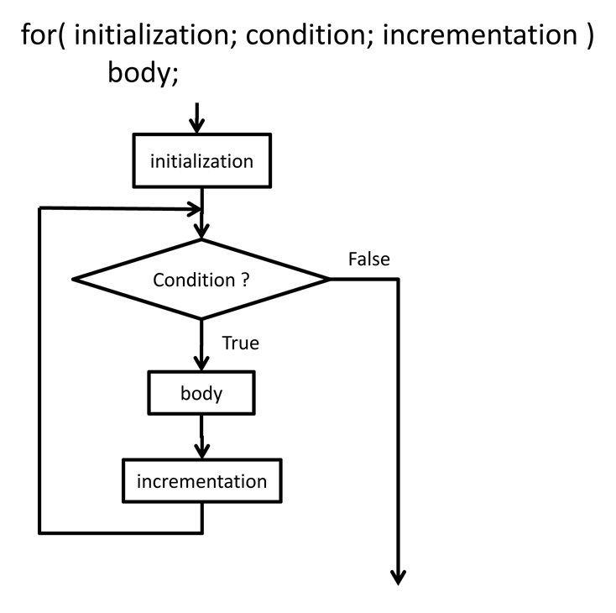
For Loop

Slide 15
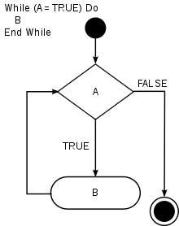
While Loop

